Slide 1
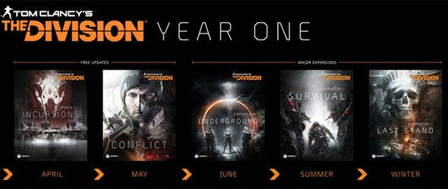
OCR Level 02 – Cambridge Technical
Unit 05 – Creating Business Solutions
2016 Specification - L/615/1355
LO4 - Recommend Additional Features for Game Design

Slide 2
Assessment Criteria
The Learner will | Pass The assessment criteria are the pass requirements for this unit. The learner can: | Merit To achieve a merit the evidence must show that, in addition to the pass criteria, the learner is able to: | Distinction To achieve a distinction the evidence must show that, in addition to the pass and merit criteria, the learner is able to:
1. Know the fundamentals of game design | P1: Describe the fundamentals of game design
2. Be able to generate Game Designs | P2: Outline the game concept | M1: Justify how the concept meets the purpose and features of the game
 | P3: Present the game concept to stakeholders to obtain feedback
 | P4: Produce the design for the game concept based on feedback
3. Be able to create games from game designs | P5: Create the game | M2: Test the functionality of the game | D1: Evaluate the game against the design specification
4. Be able to recommend additional features for game designs | P6: Recommend additional features to improve game design | M3: Consider how the additional features would enhance the original game design | D2: Justify how the game design could be supported on multi-platforms

Slide 3
LO4 – Learning Outcome
Learning Outcome 4: Be able to recommend additional features for game designs
The stakeholders are very interested in your game design and would like you to provide them with information relating to additional features and multi-platform opportunities.
Your task is to: present to stakeholders how your game could be further enhanced by recommending additional features.
Pass | Merit | Distinction
P6: Recommend additional features to improve game design | M3: Consider how the additional features would enhance the original game design | D2: Justify how the game design could be supported on multi-platform
Evidence
Report, podcast, or presentation. This must include: additional features to enhance the game design. how these additional features are beneficial to both the game and the player how the game design could be supported on different platforms. This could include the requirements of different devices or operating systems.

Slide 4
Assessment Criterion P5, M2, D1
P6 - Learners are required to recommend additional features that will improve the game design. The evidence could be in the form of a report, podcast, presentation, design documentation.
M3 - As an extension of P6, learners must consider how the additional features will enhance the original game design. This evidence could be in the form of a podcast, report or presentation and included as an extension to P6.
D2 - Learners must justify how the game design could be supported on multi-platforms both in terms of type of platform and the operating system used. The evidence could be in the form of a presentation, podcast or report.

Slide 5
LO4 - Assessment Criterion
4.1. Additional features, e.g.:
ability to play on alternative platforms
built-in help facilities
cheats
bonus scores
bonus levels
enhanced sound
auto save
optional extras (e.g. add-ons).
4.2. Benefits of additional features, e.g.:
enhanced enjoyment
increased complexity
additional element of surprise
aids collaborative and interactive gaming
player more likely to recommend game to friends
stimulates hand-eye co-ordination
brain training
retains player interest
aids movement
aids education
4.3. Multi-platform opportunities, e.g.:
standalone
mobile (e.g. smartphone)
networked
internet
different operating systems

Slide 6
Unit 15 – Scenario – Progress Game Hut
Progress Game Hut
Part A
You are a junior game designer at Progress Game Hut. To gain a promotion as a fully endorsed game designer your manager, Harry has asked you to explain to the rest of the game design team the fundamental concepts of game design.
Part B
Design, create, test and evaluate a game.
You have now been allocated a new assignment. Harry wants Progress Game Hut to release a new gaming concept for each blockbuster movie as they are released throughout the year.
Your brief is to choose a film from future movie releases and design a game to promote the movie. You could choose a concept linked to a franchise e.g. ‘007’, ‘Star Wars’, ‘Toy Story’, ‘Despicable Me’ or a completely new blockbuster.
The aim of the game is to promote the new film through entertainment and cliff hangers. Harry aims to release the games at the same time as the blockbuster hits the cinema’s.
He has asked you to think carefully about the target audience.

Slide 7
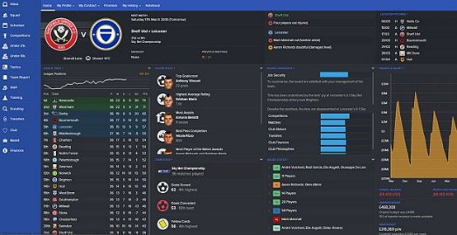
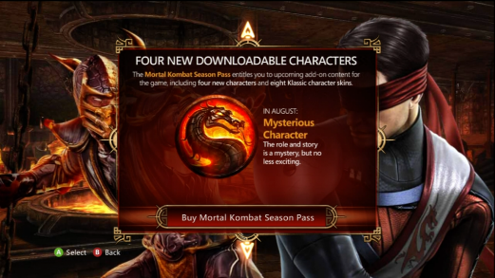
P6.1 – Recommend Additional Features
You are required to recommend additional features that will improve the game design. The evidence could be in the form of a report, podcast, presentation, design documentation.
There are two forms possible here, features to improve the game and features to extend the game.
Most modern games have an extension strategy in the form of additional content to keep the users loyal. These come in several forms:
New Areas – Skyrim had new islands and new areas, WOW has new lands, GTA opened up new cities.
New Characters – Unlocked or added characters like those in Mortal Kombat.
New Armour – Downloadable content for your characters.
New Missions – Same lands, new missions.
New Vehicles – Cars from the past, cars from the future.
New Season downloads – Football manager with season stats and updates each year. Different players.
P6.1 – Task 01 - For your game describe and recommend several possible extension content that would add to your game and explain in what form these would take.

Slide 8
P6.1 – Recommend Additional Features
The features to improve the game and features to extend the game. This could be to improve the way it looks, add more detail to the backgrounds, enhance the way the character moves or the levels are formed.
P6.1 – Task 02 - For your game describe and recommend several possible enhanced features that would add to your game and explain in what form these would take.
For my game for instance I would do the following:
Increase the umber of levels in the family home to include the garden, cellar and garage, this would give it a more expansive and family feel to the game if there were references to household assets.
I would expand the character range to more modern toys in order to encourage a more modern child audience with references to their current toy collections (Lego for instance)
In terms of quality I would parallax scroll the background to give it a more 3D effect.
Add 3D glasses to the buzz lightyear character so he can see through objects to help solve puzzles.
Add in the new song from the film at the intro screen.

Slide 9
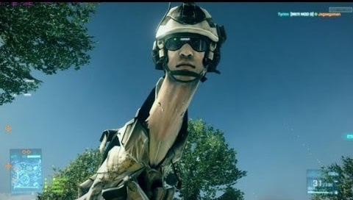
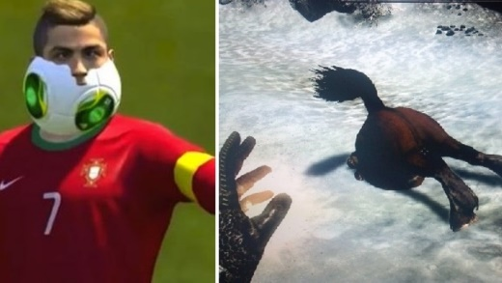
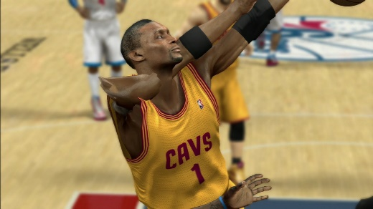
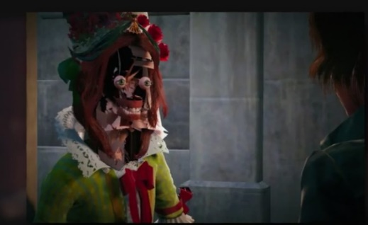
M3.1 – Recommend Additional Features
As an extension of P6, learners must consider how the additional features will enhance the original game design. This evidence could be in the form of a podcast, report or presentation and included as an extension to P6.
M3.1 – Task 03 - In your report describe in detail how the additional features would enhance the original game design
For this outline with each suggested change the following:
How the change would affect gameplay (appealing to target audience, lengthening game time, adding to the realism, in keeping with the film)
How it would affect the fun element (bug fixes, removing glitches, changing the way the game scenario is played out with a different character or different start)
How the change might be implemented (DLC, upgrade, Enhanced Version and why)
Issues that might arise from the improvement (losing saved games, issues downloading, file size, compatibility, location of improvements, error messages and how to report them)

Slide 10
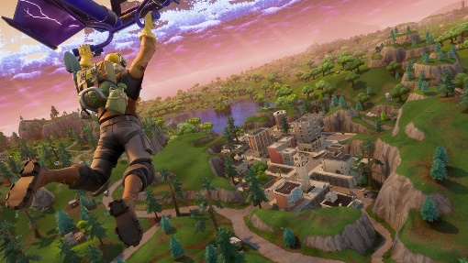
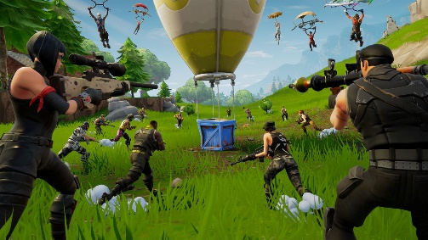
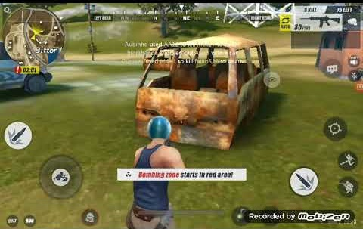
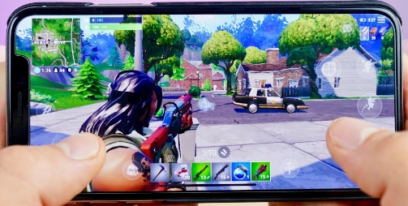
D2.1 – Cross Platform Versions
Sooner or later the game, after release, gets released on additional formats, platforms, those studied in LO1. For D2 you need to create a report of how and the issues involved in cross platform transition.
For example, my game might be transferred to Android on a Tablet but the quality of the graphics would have to be reduced otherwise there would be serious speed issues, especially on older tablets. The variety of levels (Platform, then Racing, then puzzle etc.) might need stripping back due to memory issues. The code for the game will have been written in OC language (C++) and would need to be rewritten in Android language or the game engine would need to resave it in android format and retesting would have to take place and bug fixing.
D2.1 – Task 04 – In a presentation, podcast or report, justify how the game design could be supported on multi-platforms.
For this task you need to consider the following:
The hardware requirements of different devices
How the game might be adapted for different Operating Systems (OSX compliance or Android)
What would have to be sacrificed.
How would the game be adapted.
How would the controls change.
Comparison evidence form another game that has made the leap to other devices.
PC
XBox
Tablet
Phone

Slide 11
LO4 – Assessment Criteria
P6.1 – Task 01 - For your game describe and recommend several possible extension content that would add to your game and explain in what form these would take.
P6.1 – Task 02 - For your game describe and recommend several possible enhanced features that would add to your game and explain in what form these would take.
M3.1 – Task 03 - In your report describe in detail how the additional features would enhance the original game design
D2.1 – Task 04 – In a presentation, podcast or report, justify how the game design could be supported on multi-platforms.

